Slide 1

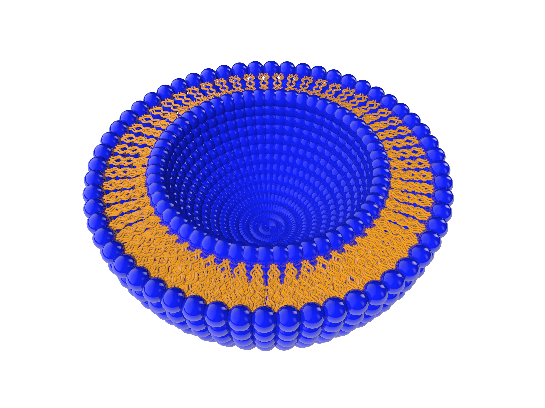
WHITEPAPER
PHYSICOCHEMICAL PROPERTIES OF LIPOSOMAL ADVANCED DRUG DELIVERY TECHNOLOGIES
intertek.com/pharmaceutical

Slide 2
ABSTRACT
Liposomes are having an increasing impact in the field of advanced drug delivery. They can help protect and stabilise therapeutic compounds and overcome obstacles to cellular and tissue uptake, enabling effective delivery of encapsulated compounds to target sites while minimizing systemic toxicity.
In this whitepaper, Intertek’s Justine Ponzi, Senior Scientist, describes analytical approaches to evaluate the physicochemical properties of liposomes for drug delivery systems according to the FDA Guidance for Liposome Drug Products, Chemistry, Manufacturing, and Controls; Human Pharmacokinetics and Bioavailability; and Labeling Documentation.
Click on the button below to download the whitepaper.
DOWNLOAD WHITEPAPER
Tel: +44 161 721 5247
Email: biopharma@intertek.com
intertek.com/pharmaceutical

